Slide 2

UI/UX Design – MentorHub System Communication Subsystem
Bao Ly | 29.05.2024

Slide 3

Agenda
Mind Map
Use Case Diagram
UI Design
Home
Edit Profile
Direct Message
My Cloud
Video Call
Meeting
Calendar
Activity
Preferences

Slide 4
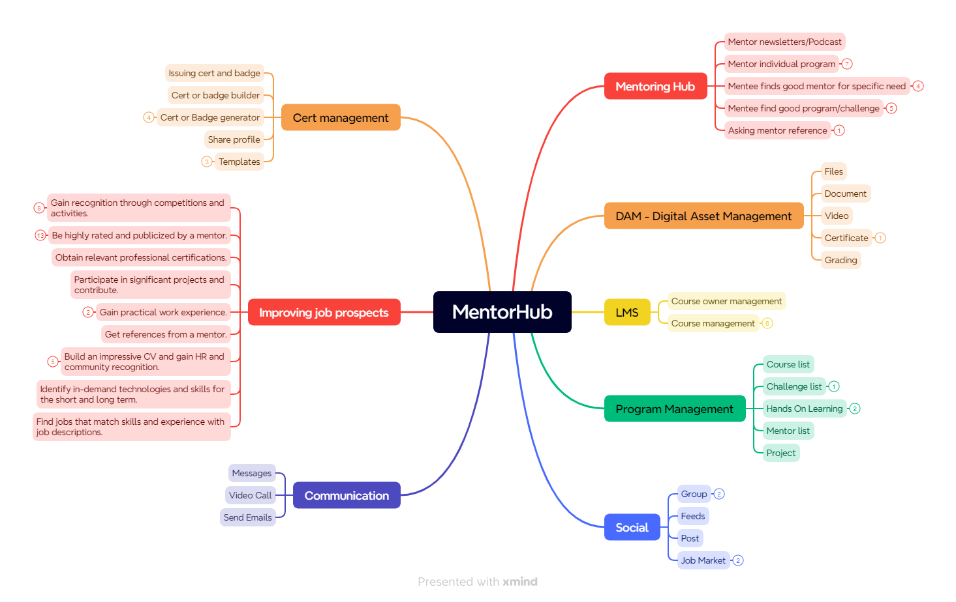
Mind Map – Mentor Hub

Slide 5
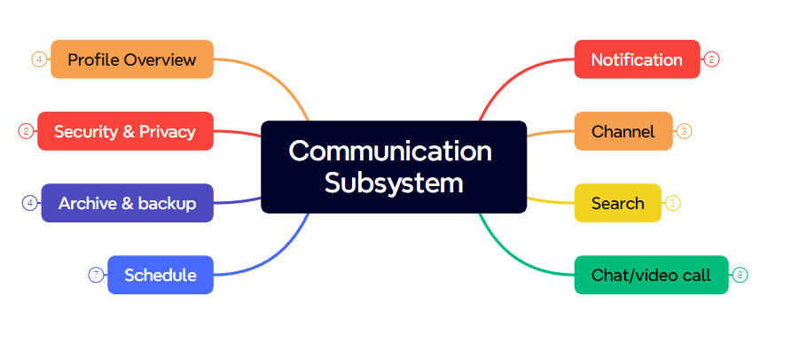
Mind Map – Communication Subsystem

Slide 6
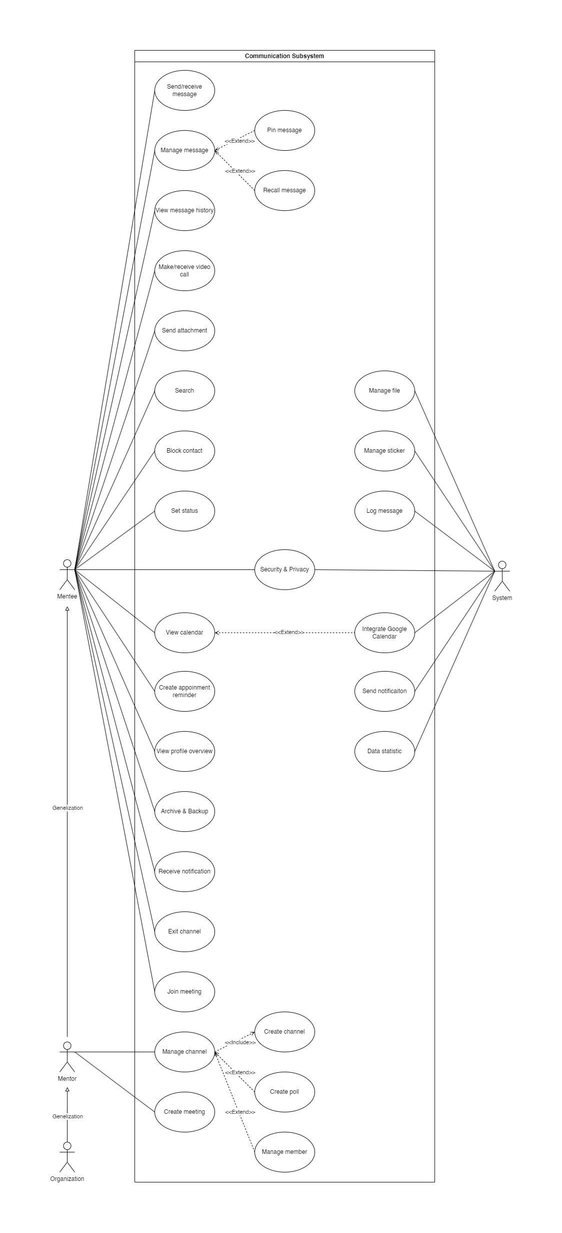
Use Case Diagram

Slide 7
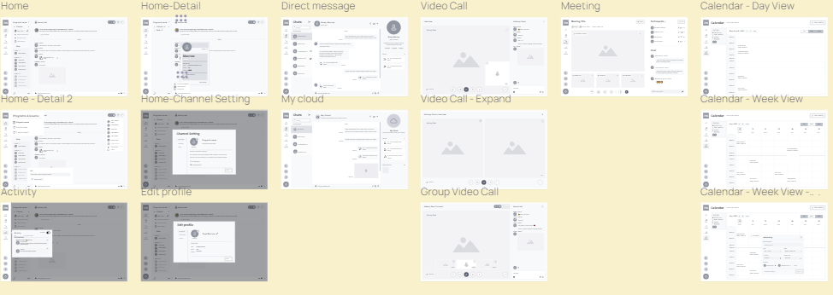
UI Design

Slide 8
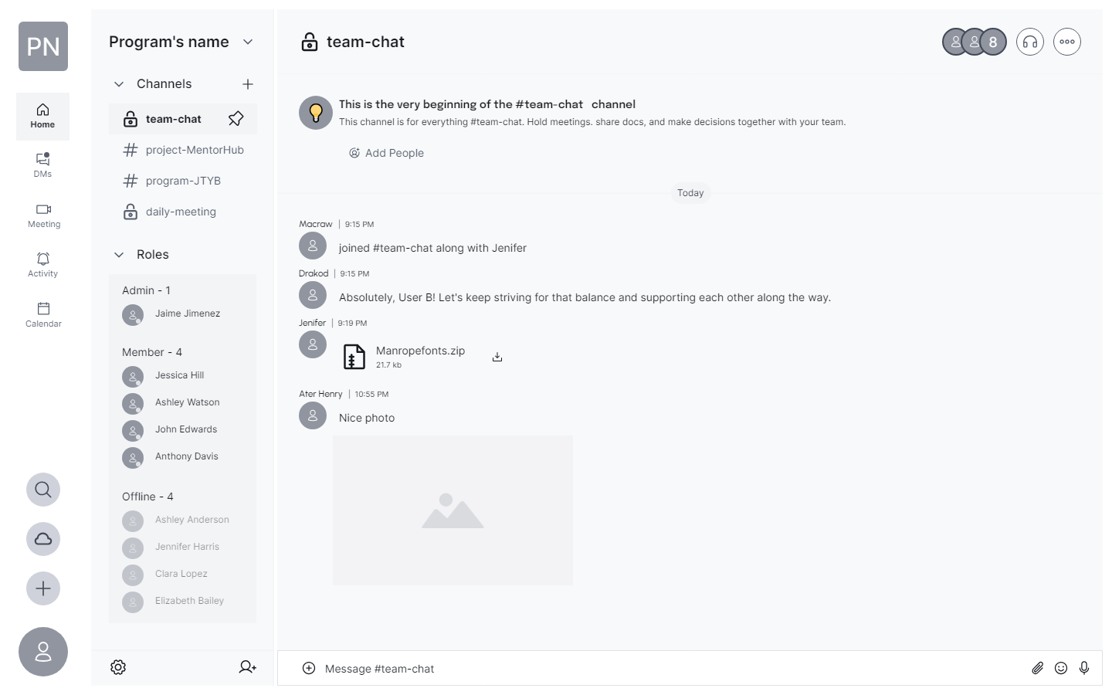
Home

Slide 9
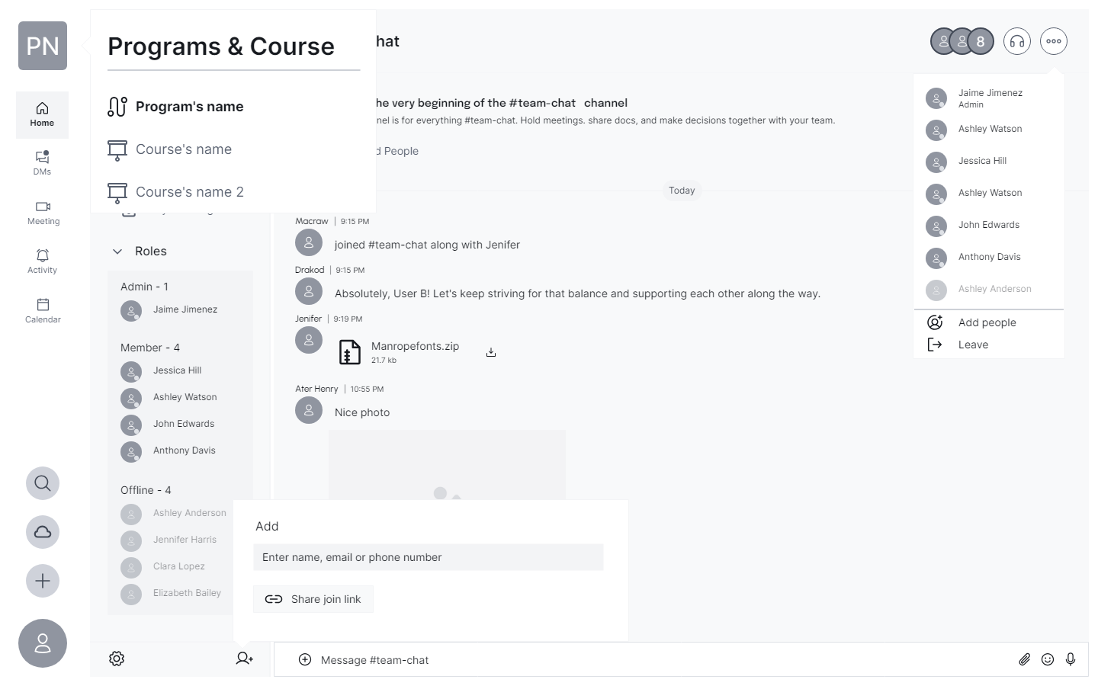
Home - Detail

Slide 10
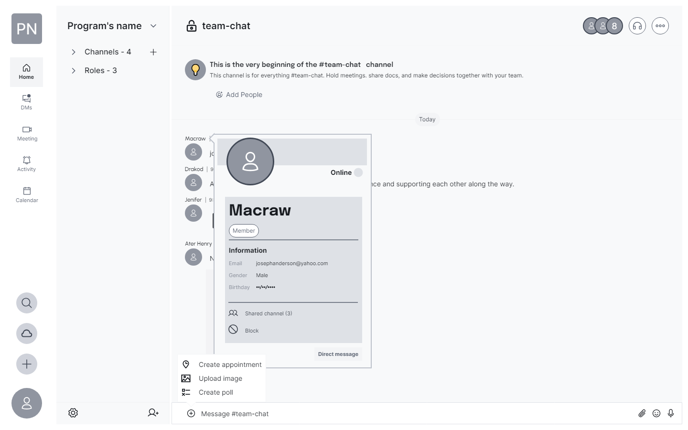
Home - Detail

Slide 11
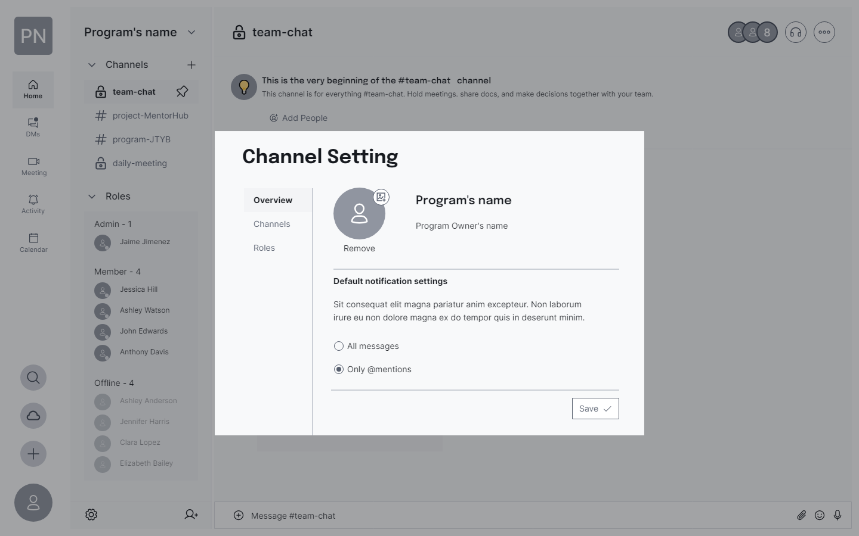
Home – Channel Setting

Slide 12
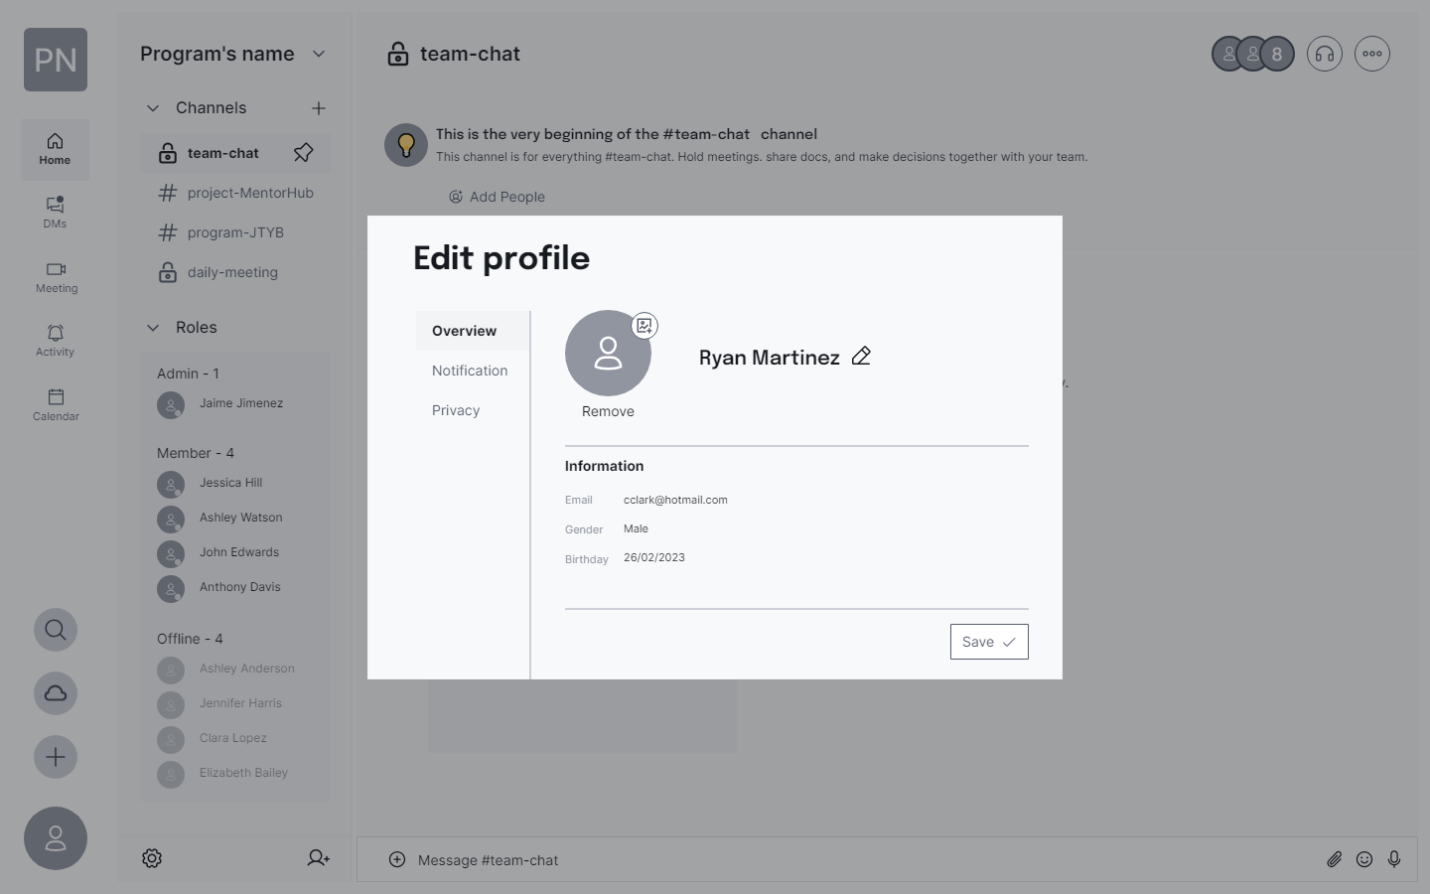
Edit Profile

Slide 13
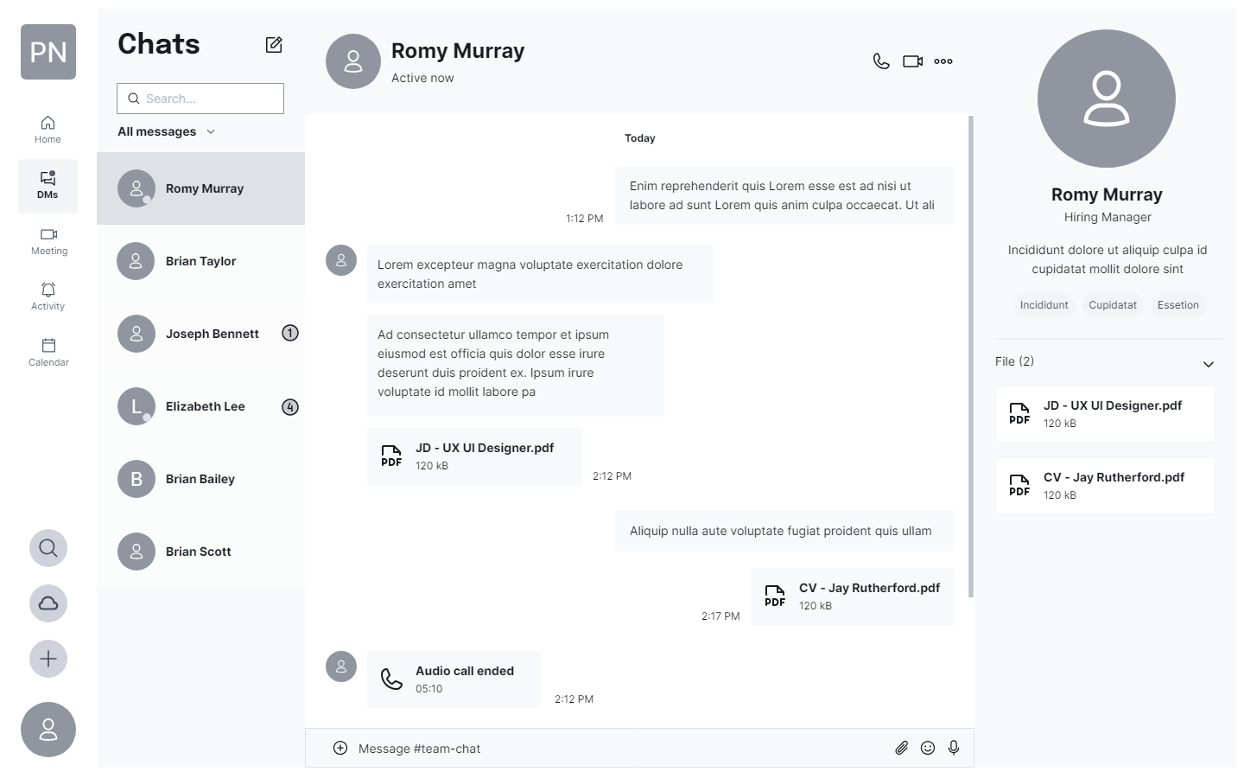
Direct Message

Slide 14
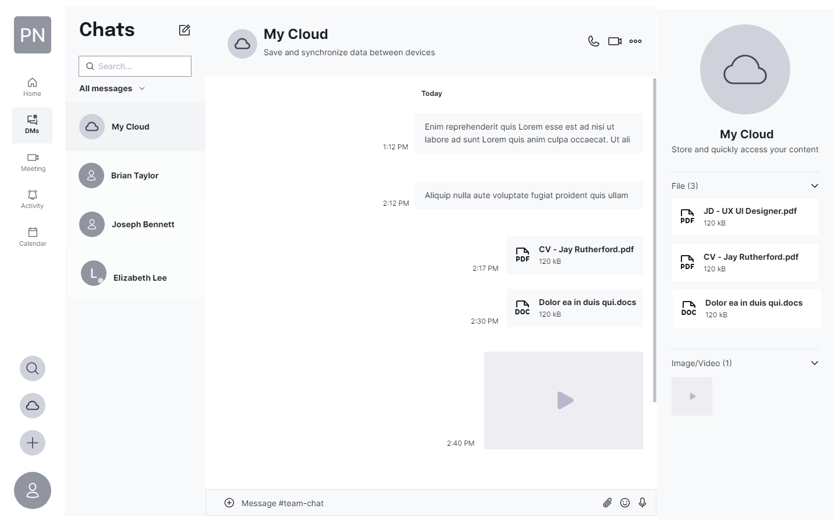
My Cloud

Slide 15
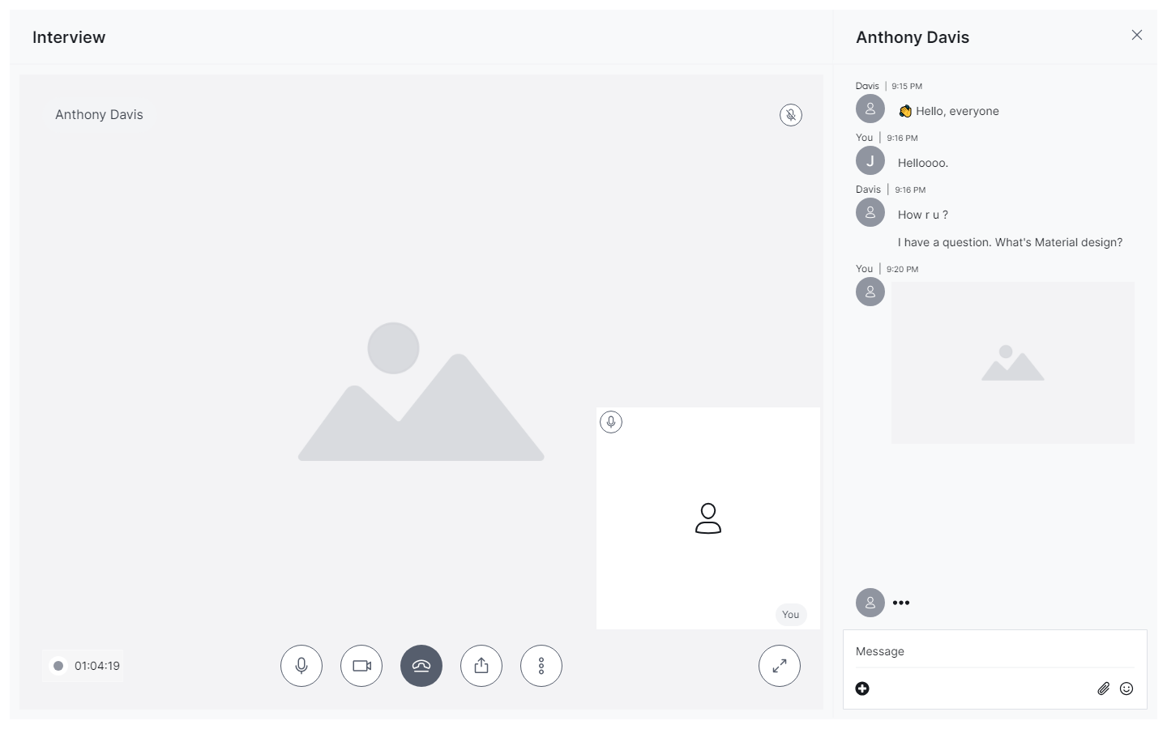
Video Call

Slide 16
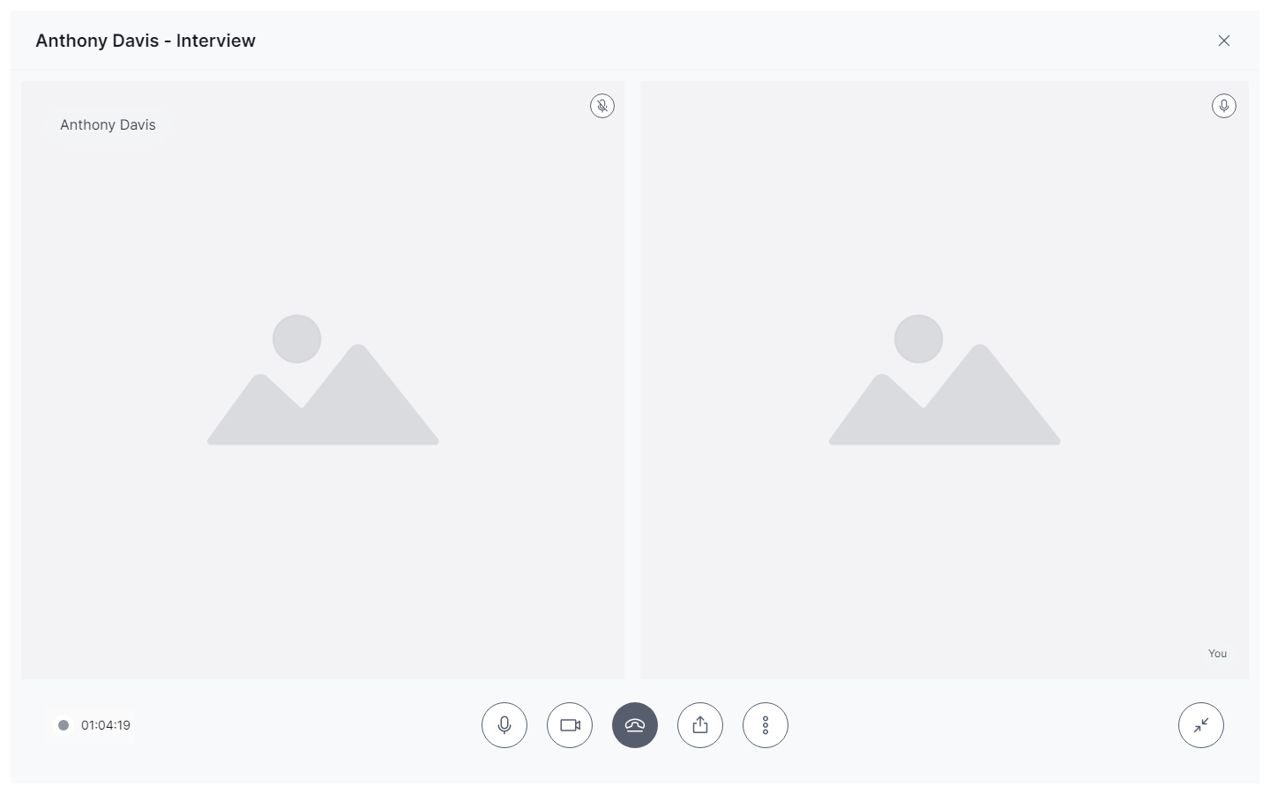
Video Call – Expand

Slide 17
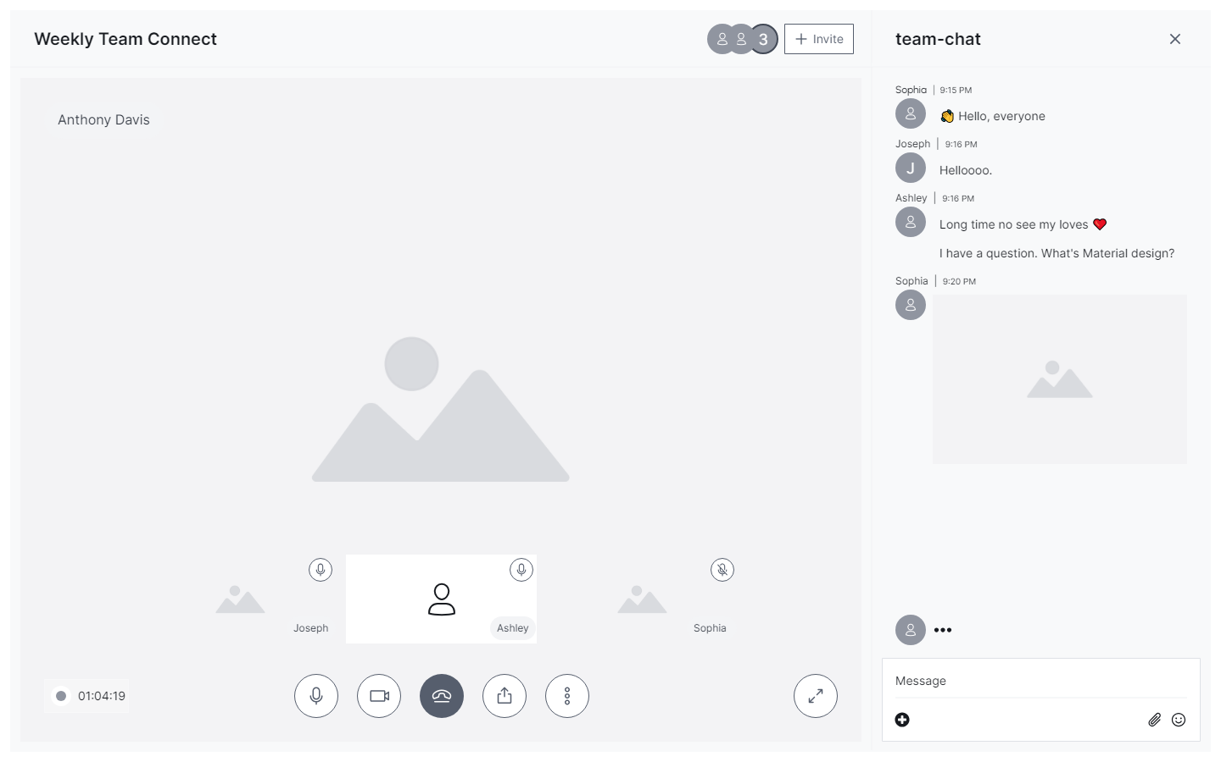
Video Call – Group

Slide 18
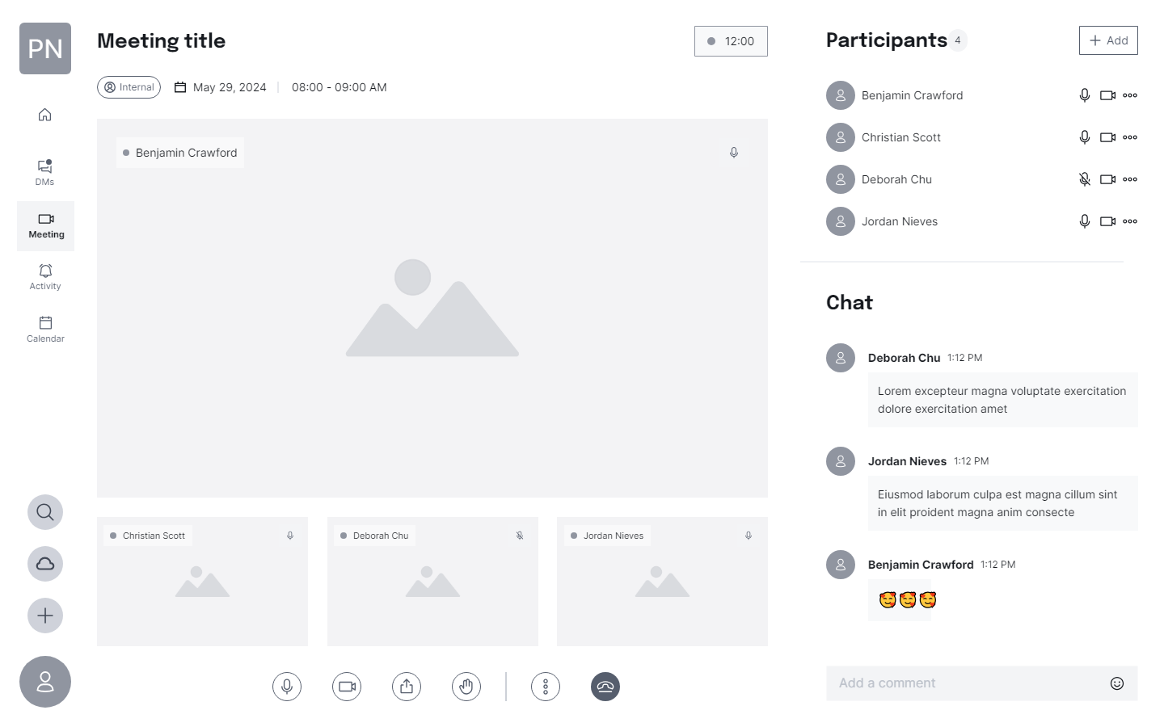
Meeting

Slide 19
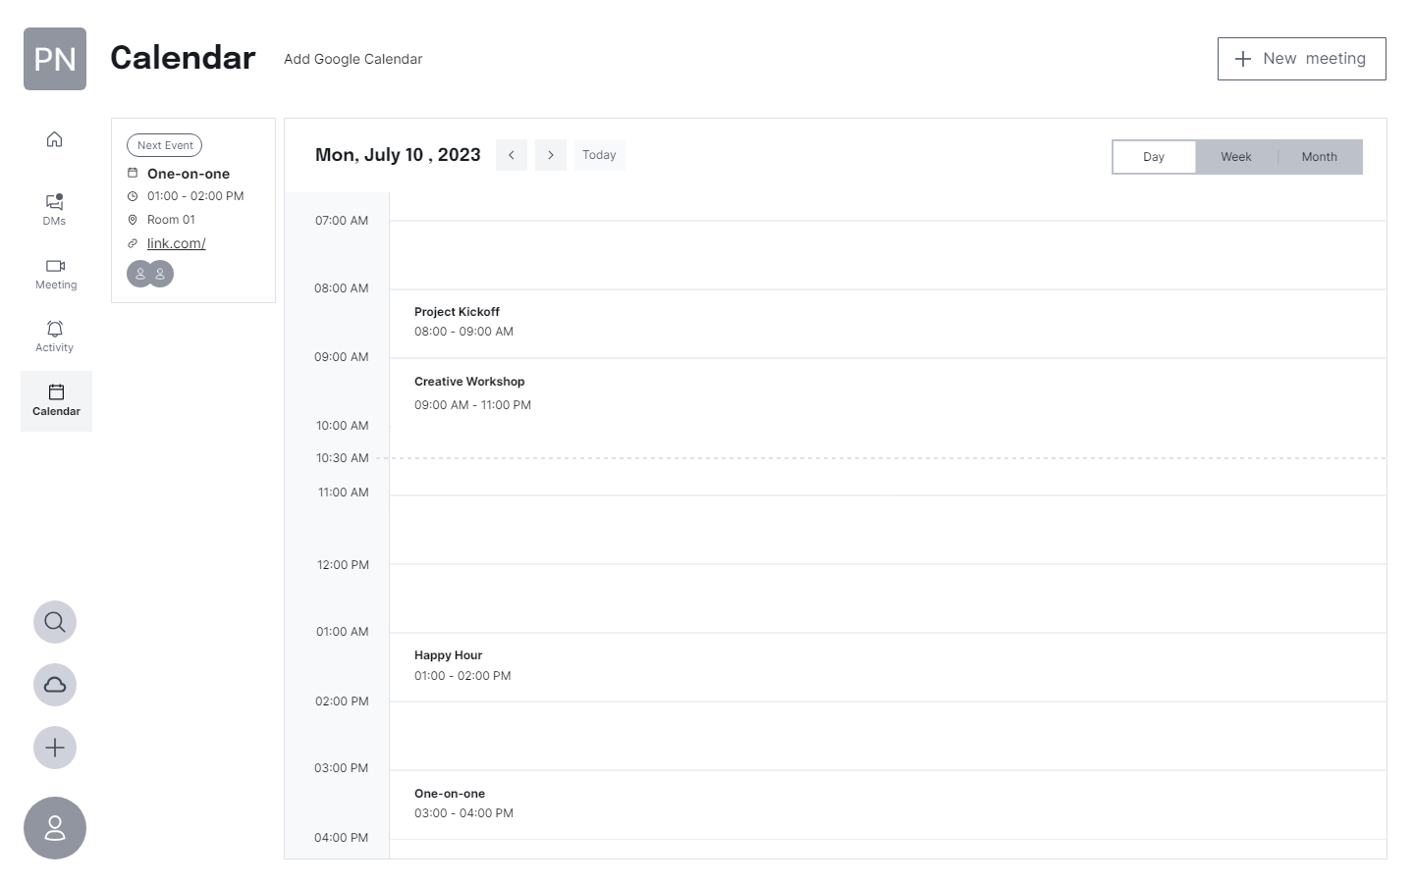
Calendar – Day view

Slide 20
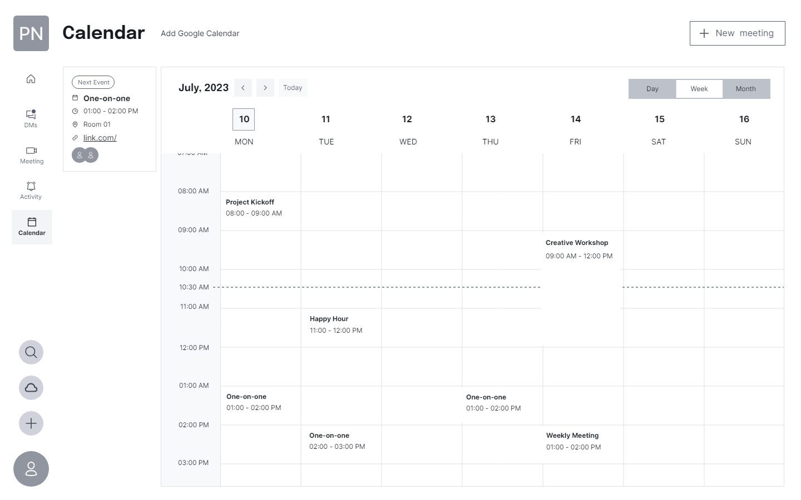
Calendar – Week view

Slide 21
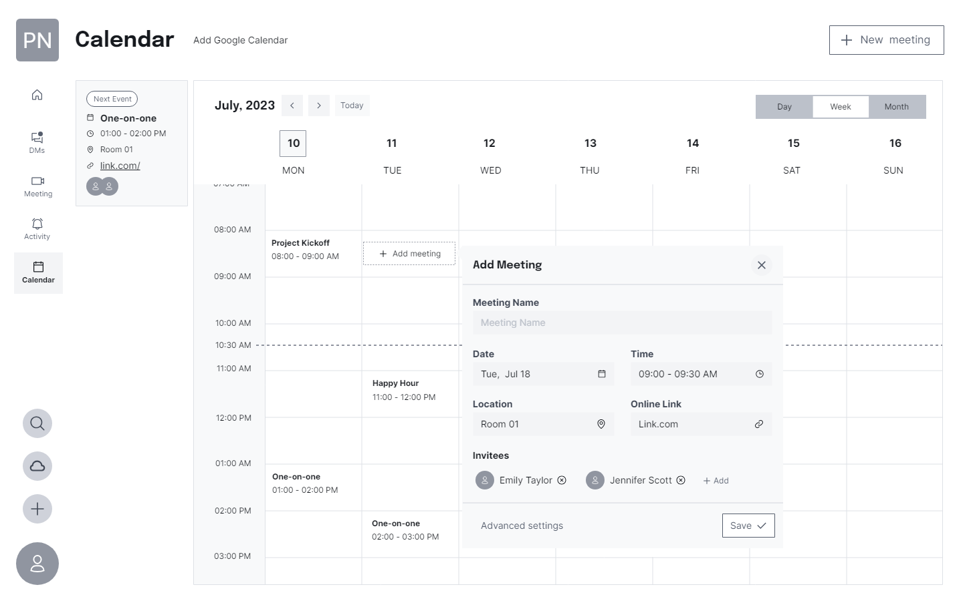
Calendar – Week view – Add meeting

Slide 22
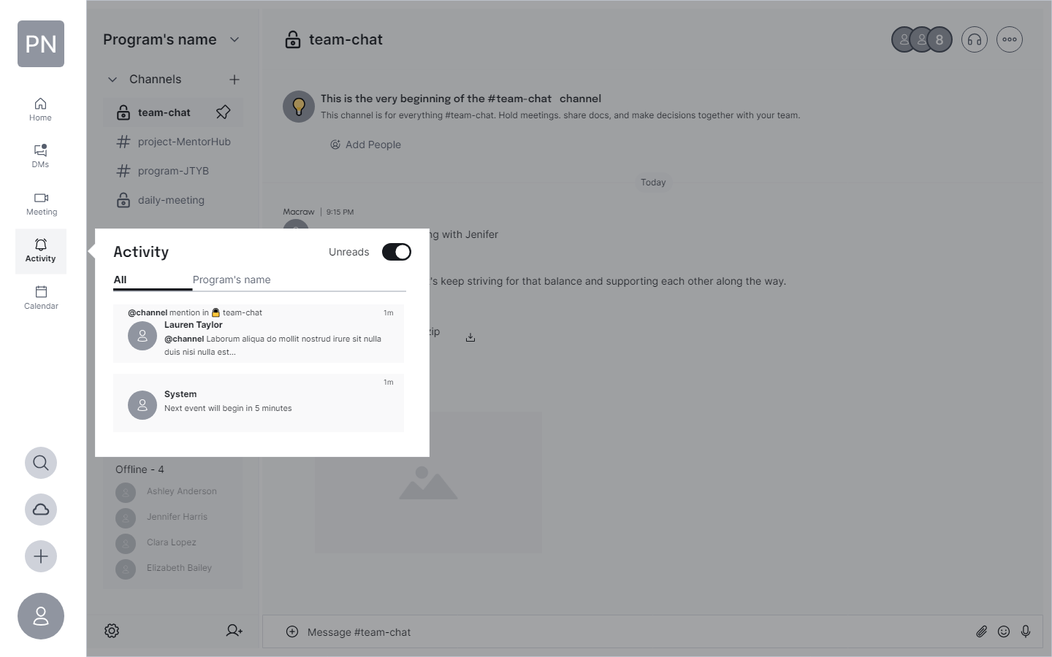
Activity

Slide 23
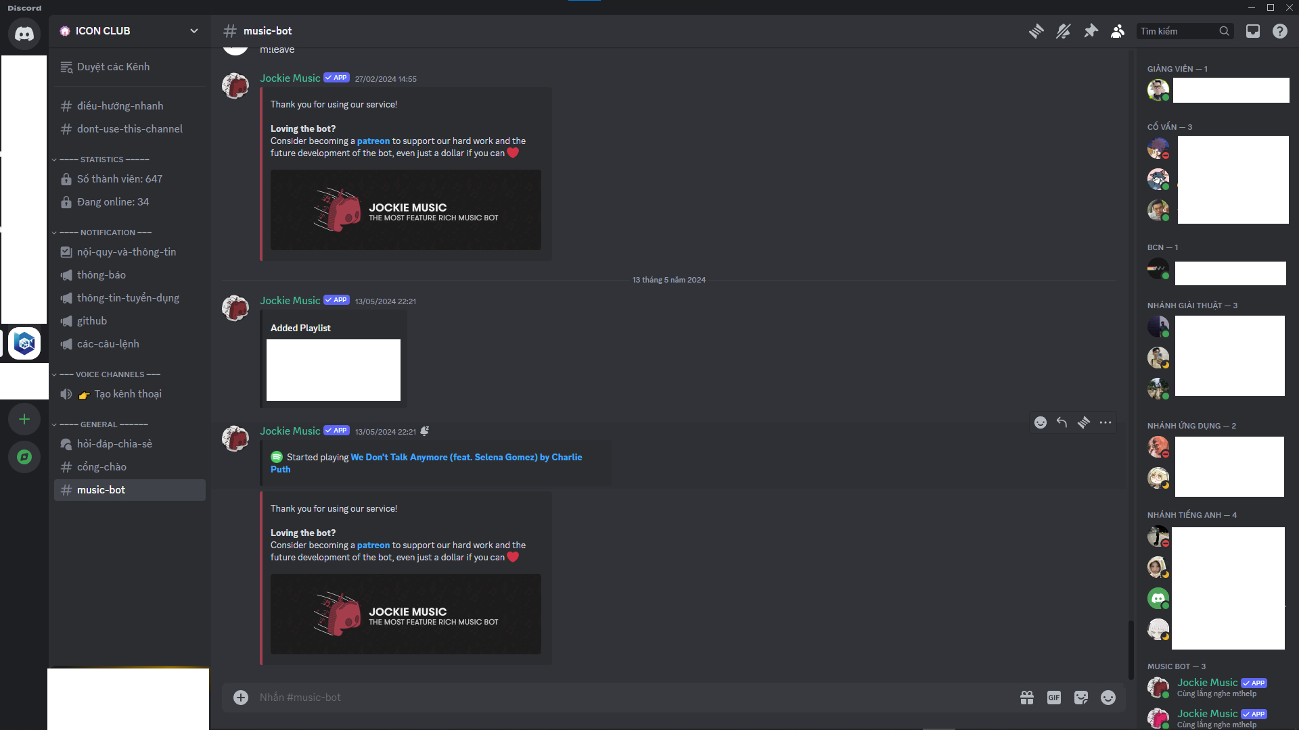
References – Manage channel
Discord
A VoIP and instant messaging platform primarily for gaming communities and IT communities.

Slide 24
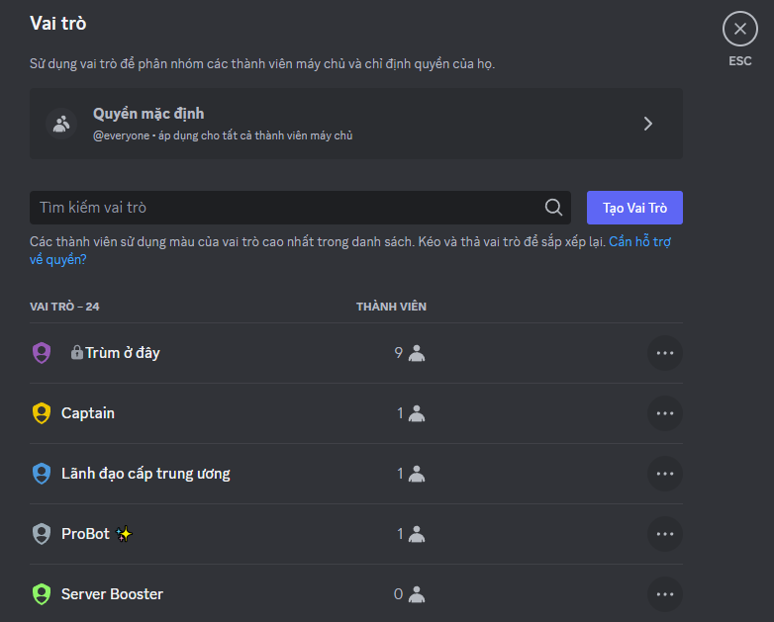
References – Manage channel
Discord

Slide 25
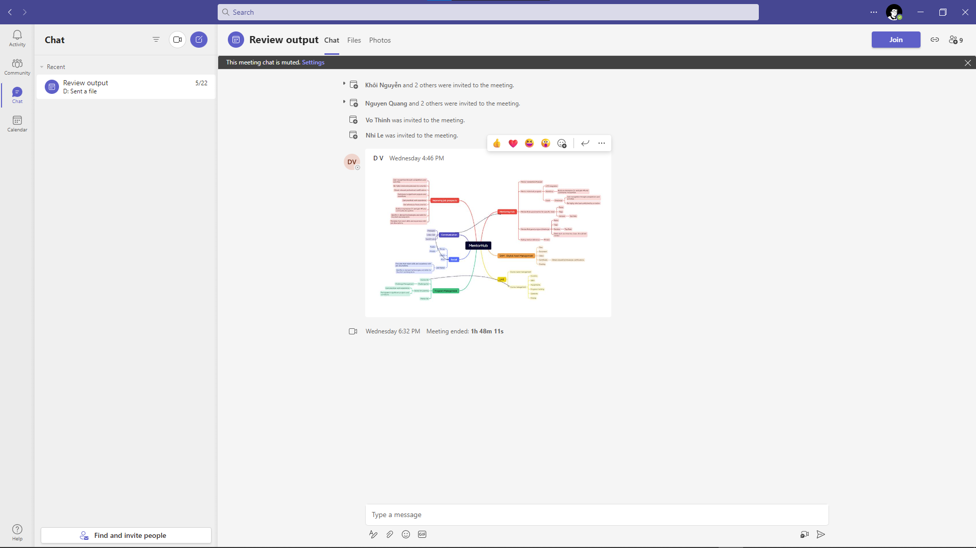
References – Manage channel
Teams
A collaboration tool that integrates with Office 365 for chat, meetings, and file sharing.

Slide 26
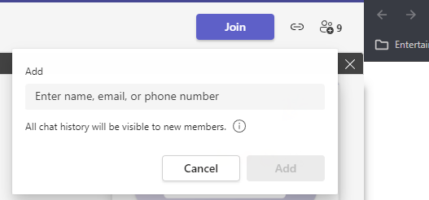
References – Manage channel
Teams

Slide 27
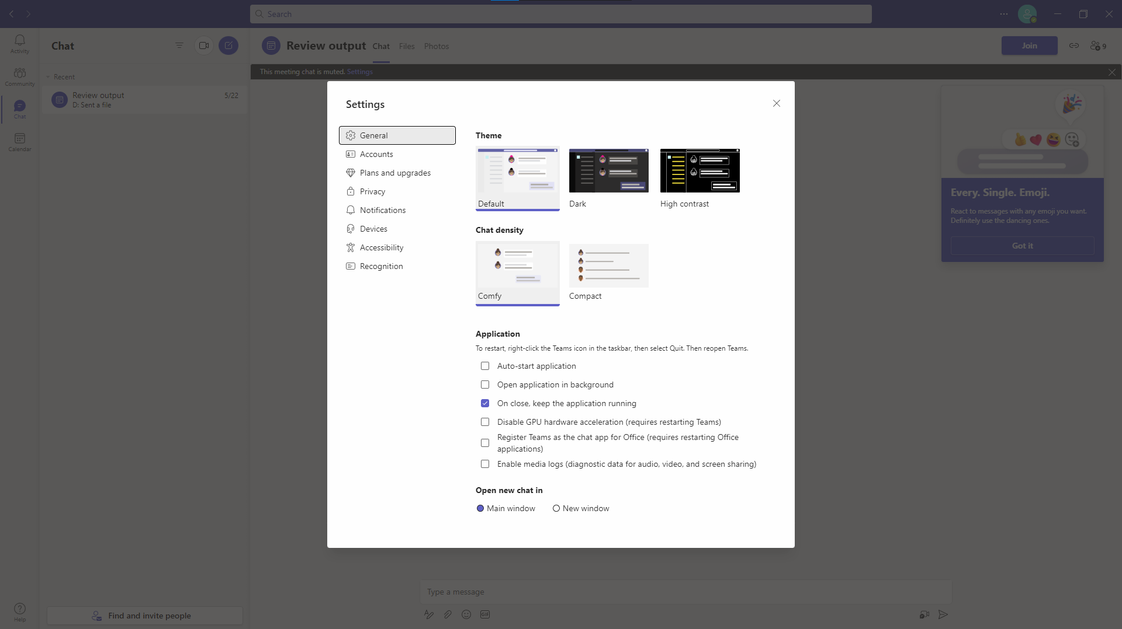
References – Manage channel
Teams

Slide 28
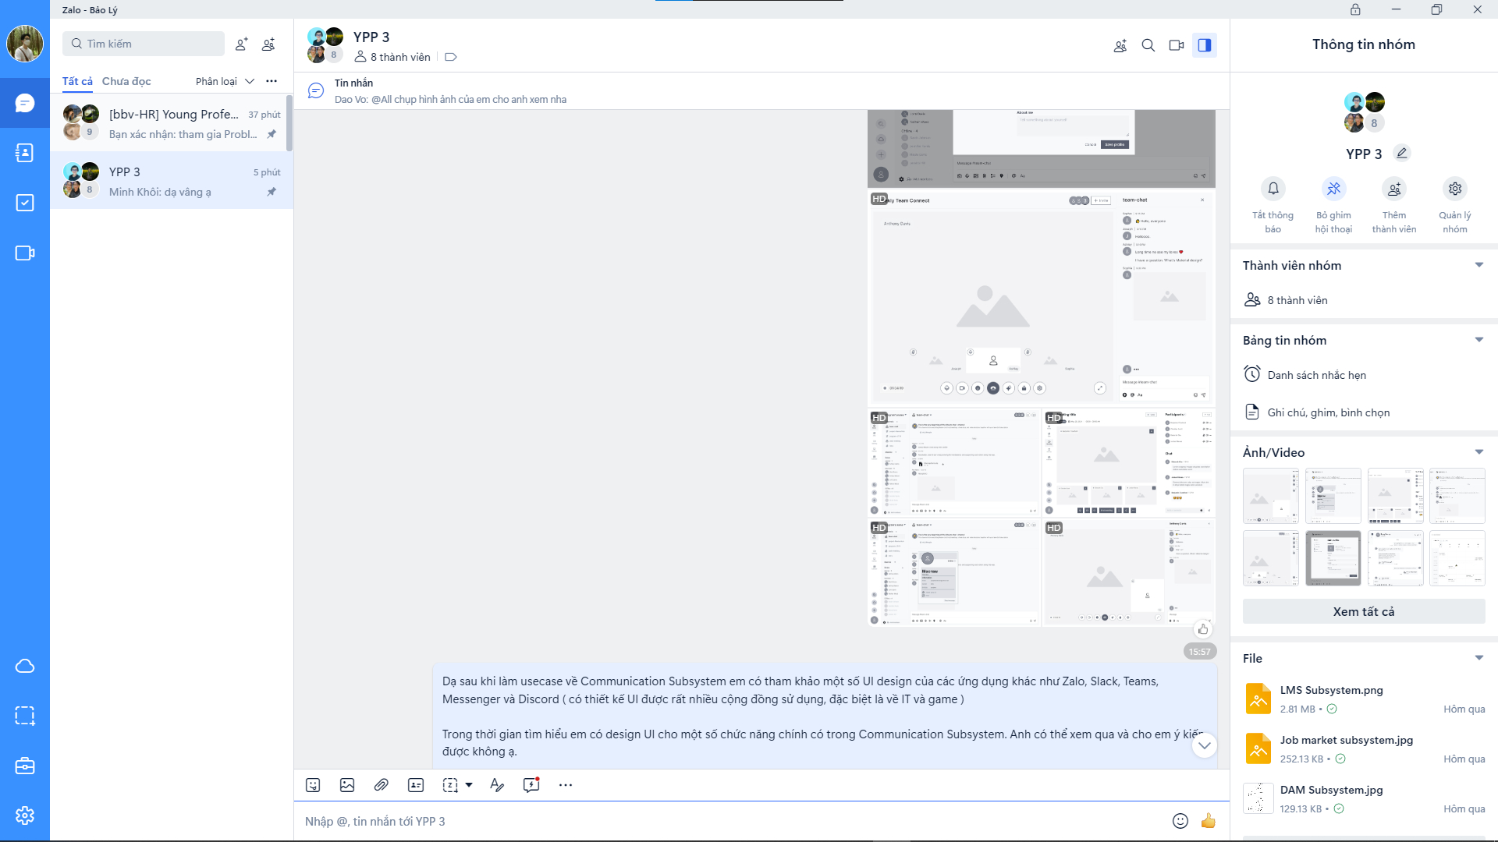
References – Direct message
Zalo

Slide 29
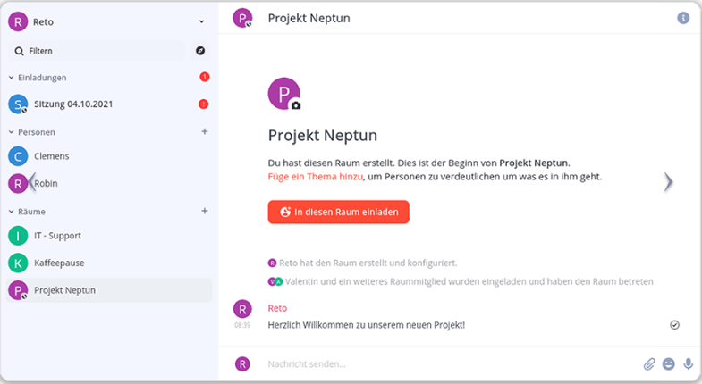
References – Direct message
IntraHub
IntraHub is a secure Swiss productivity platform that allows teams to collaborate easily online. The tool serves as an internal hub for all documents, communication and project planning in a team or company.

Slide 30
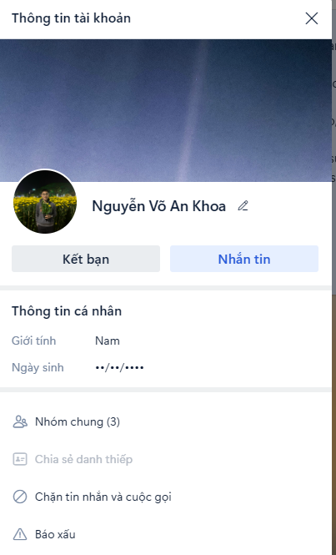
References – User profile
Zalo

Slide 31
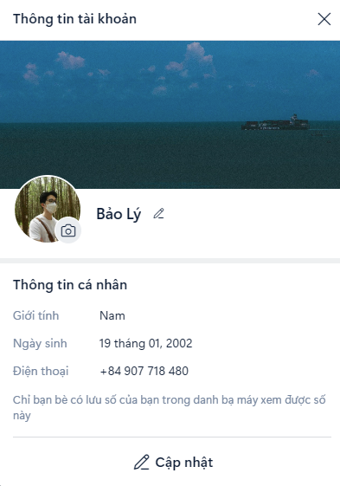
References – User profile
Zalo

Slide 32
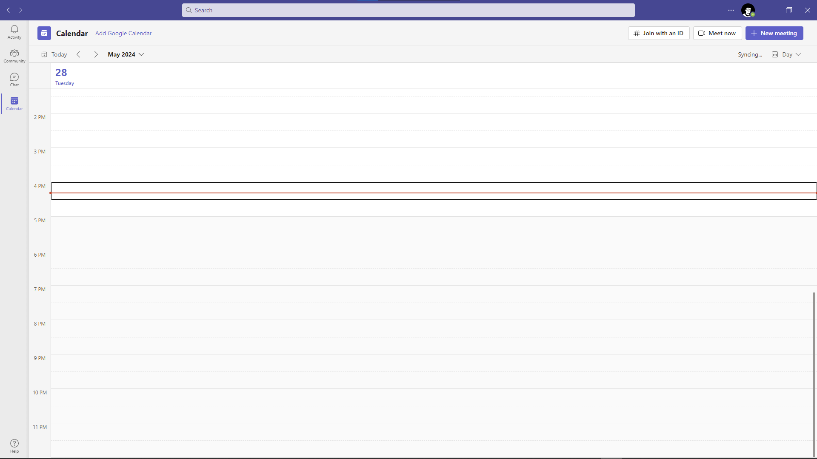
References – Calendar & Meeting
Teams

Slide 33
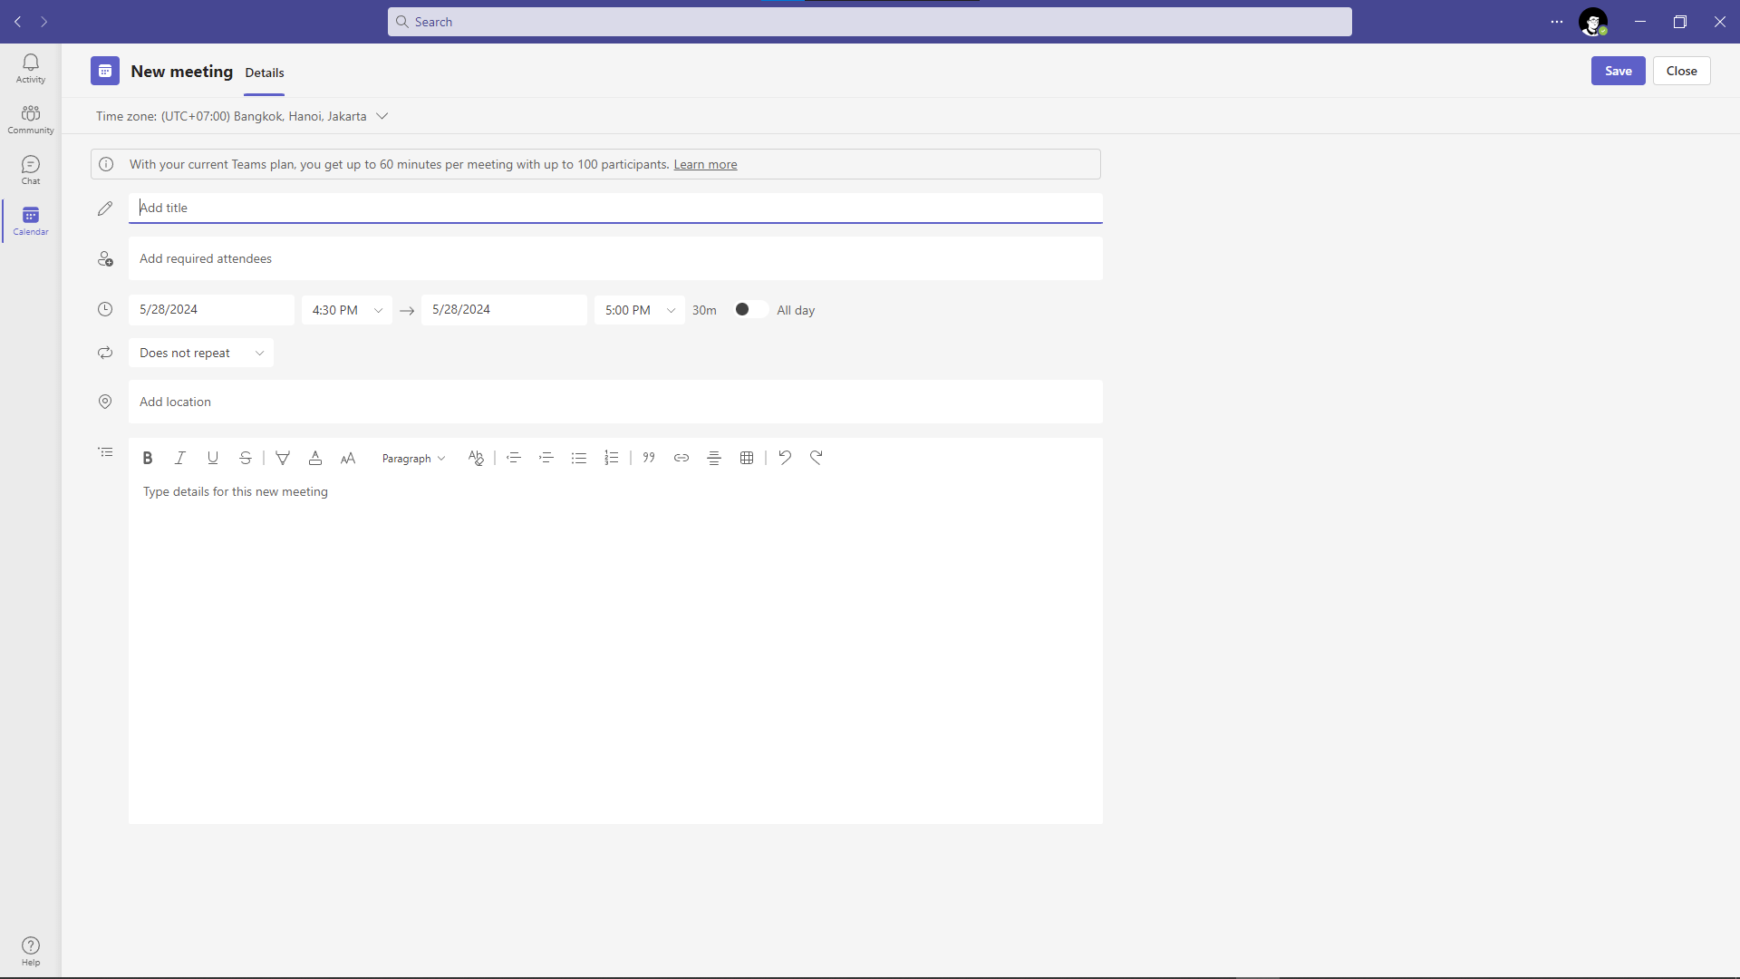
References – Calendar & Meeting
Teams

Slide 34
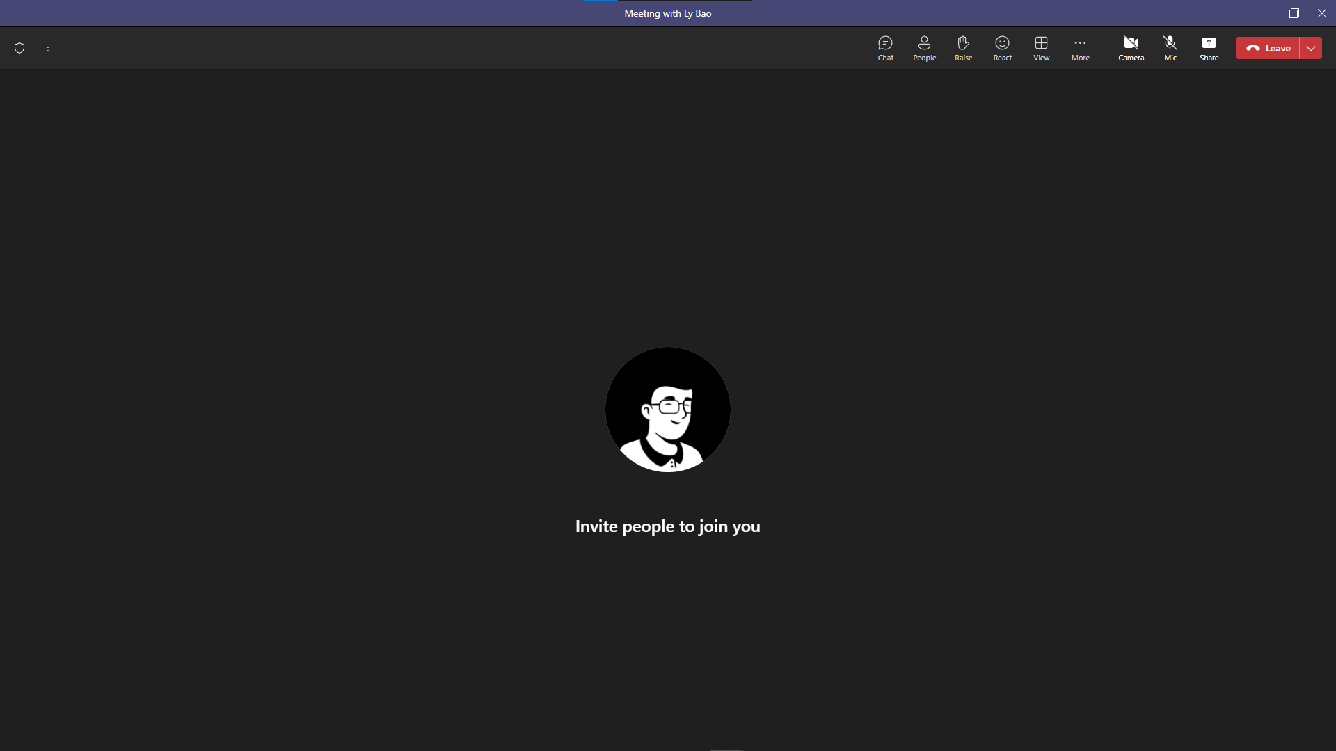
References – Calendar & Meeting
Teams

Slide 35
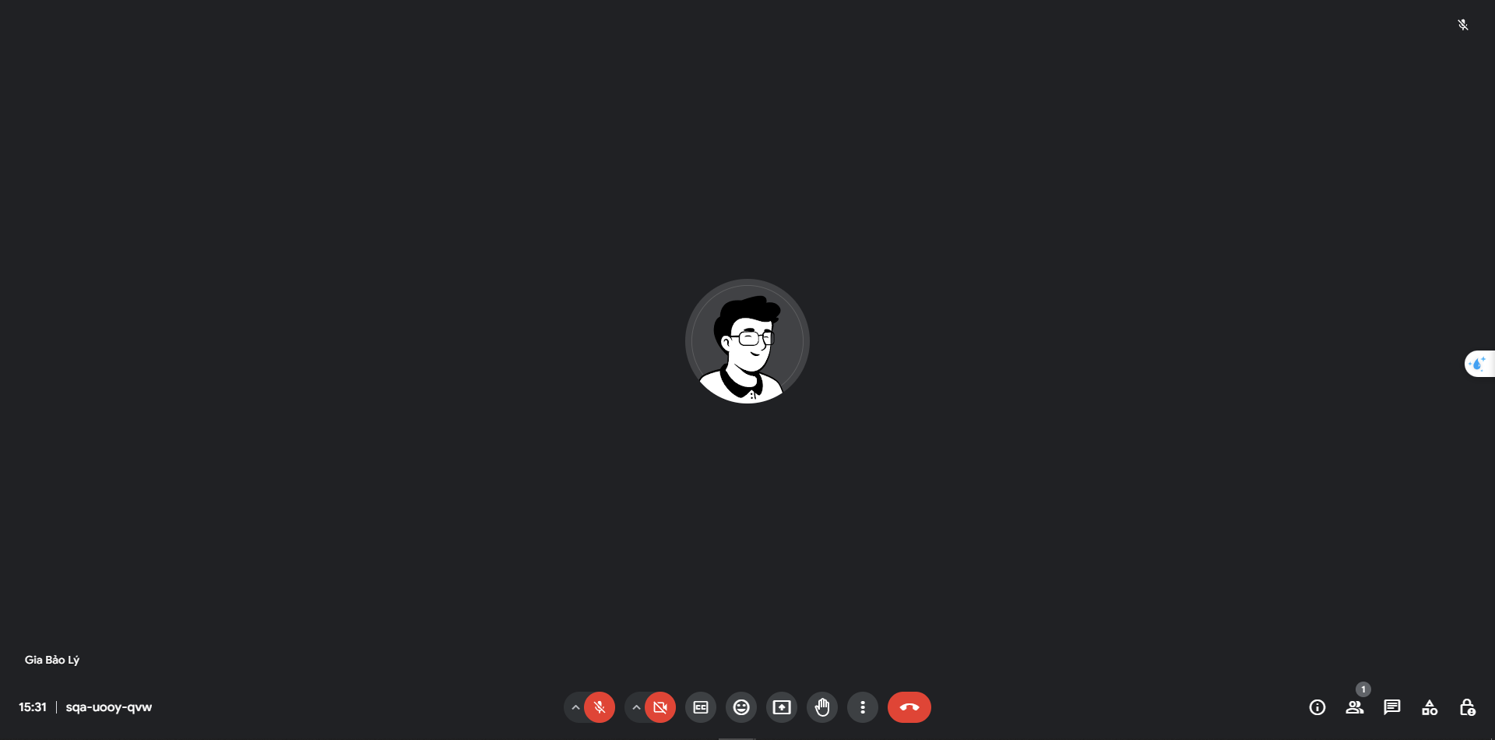
References – Calendar & Meeting
Google Meeting

Slide 36
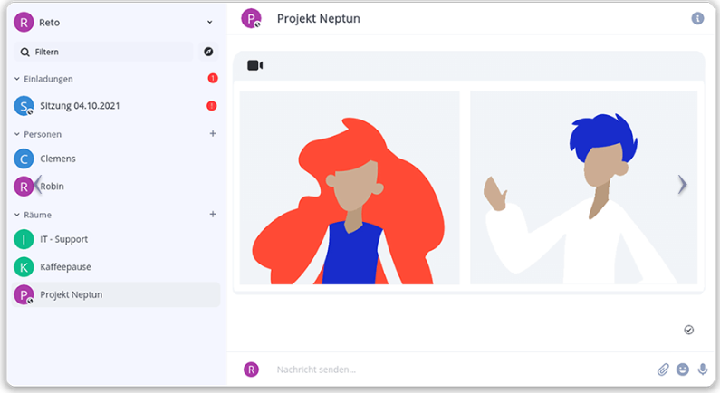
References – Video Call
IntraHub

Slide 37
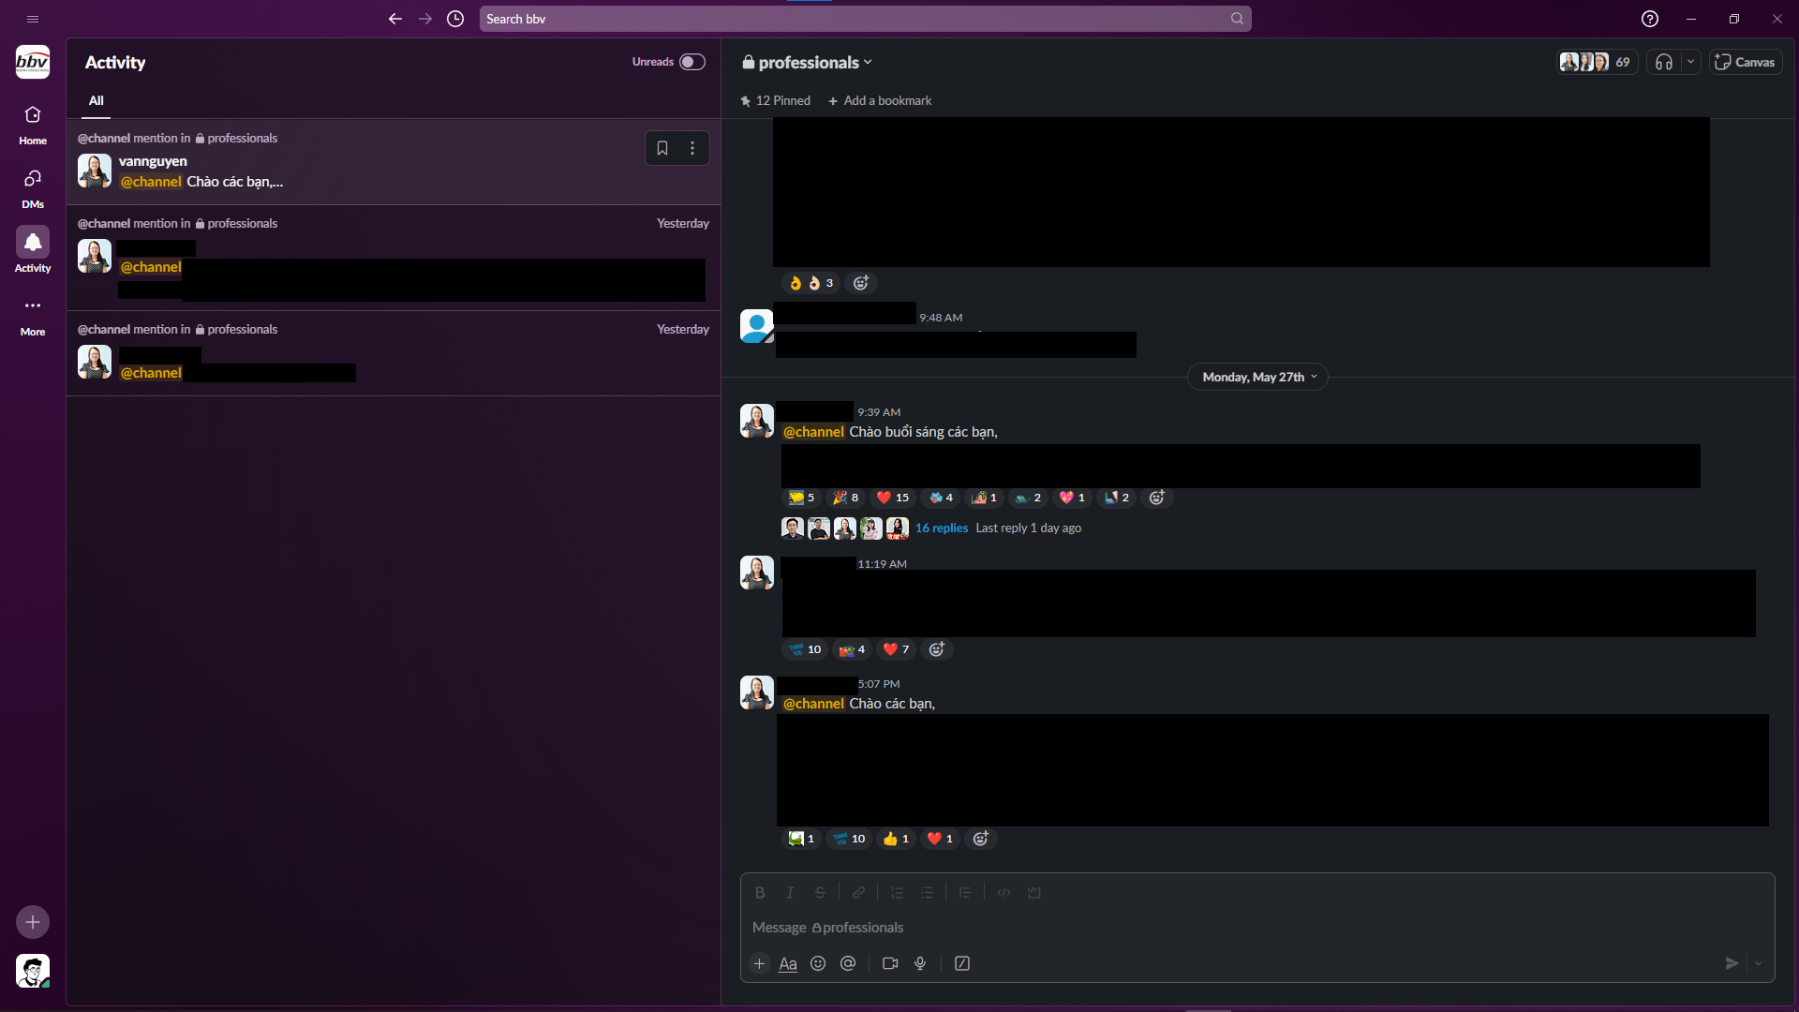
References - Activity
Slack
A business communication platform for team collaboration and messaging.

